Slide 1
50.003: Elements of Software Construction
Week 3
Object-Oriented Design Patterns

Slide 2
Motivation
How do we do software design in general?
We don’t know.
But there are principles and patterns that we could follow at times.

Slide 3


Language and Tools
http://www.eclipse.org/

Slide 4
Plan for the Week
Class 1:
Review of Basic OOP Concepts
Design Patterns: Factory design patterns
Class 2:
Strategy design patterns, Observer design patterns, Abstract factory design patterns, Singleton design pattern, etc.

Slide 5
Class
A class is a blueprint.
Fields (instance variables)
What an object knows
Methods (Functions)
What an object does
class Anmial {
private String name;
private double height;
private int weight;
private String favoriateFood;
private double speed;
public Animal() { … }
public void move(int) { … }
public void eat() { … }
public void setName(String name) { … }
public String getName() { … }
}

Slide 6
Inheritance
What do classes have in common?
Abstract out those features
Override or extend methods that don’t work
Define only the changes in the sub-class
class Anmial {
…
public Animal() { … }
public void move(int i) { … }
public void eat() { … }
public void setName(String name) { … }
public String getName() { … }
}
class Dog extends Animal {
public void digHole () { … }
}
class Bird extends Animal {
public void move (int i) { … }
}

Slide 7
What is Encapsulation?
public class Animal {
private String name;
private double height;
int weight;
public void setWeight(int newWeight){
if (newWeight > 0){
weight = newWeight;
} else {
System.out.println("Weight must be bigger than 0");
}
}
}
Encapsulation protects the data.

Slide 8
Instance and Local Variables
Fields (instance variables) are declared in the class
Local variables are declared in a method
class Anmial {
private int weight;
public double getGrams() {
double gramMult = 1000;
return gramMult*weight;
}
}

Slide 9
When to User Inheritance
Is A? helps you decide if a class should extend another
Is a dog an animal?
Is a dog a cat?
Has A? helps you decide if something is a field
Dog has a height?
When a subclass needs most of the methods in a superclass
Don’t use inheritance just to reuse code if they don’t have a “Is A?” relationship.

Slide 10
What is Polymorphism?
A single thing to entities of different types.
For example,
Animal doggy = new Dog();
Animal kitty = new Cat();
kitty.getSound() executes the Cat method
You can’t access methods this way if they are only in the subclass though.
class Anmial {
… //field variables
public Animal() { … }
public void move(int i) { … }
public void eat() { … }
public void setName(String name) { … }
public String getName() { … }
public String getSound() {…}
}
class Dog extends Animal {
public String getSound () { return “Woof”;}
}
class Cat extends Animal {
public String getSound () { return “Meow”;}
}

Slide 11
Quick Question
Is this correct?
Animal doggy = new Dog();
doggy.digHole();
class Anmial {
… //field variables
public Animal() { … }
public void move(int i) { … }
public void eat() { … }
public void setName(String name) { … }
public String getName() { … }
}
class Dog extends Animal {
public String digHole () { … }
}

Slide 12
What is an Abstract Class?
abstract public class Creature{
protected String name;
protected double height;
protected int weight;
protected String favFood;
public abstract void setName(String newName);
public abstract String getName();
public abstract void setHeight(double newheight);
public abstract double getHeight();
public abstract void setWeight(double newWeight);
public abstract double getWeight();
public abstract void setFavFood(String newFood);
public abstract String getFavFood();
}

Slide 13
What’s an Interface
A class with only abstract methods
You can add as many interfaces to a class using implements as you want
You can only use public static and final fields
public interface Living {
public void setName(String newName);
public String getName();
public void setHeight(double newheight);
public double getHeight();
public void setWeight(double newWeight);
public double getWeight();
public void setFavFood(String newFood);
public String getFavFood();
}
public class Monkey implements Living {
…
}
Can we inherit multiple classes in Java?

Slide 14
Cohort Exercise 1 (10 min)
Consider classes Radish and Carrot which both extend class Vegetable and implement interface Crunchable. Which of the following sets of assignments are legal and why?
Radish radish = new Radish();
Radish radish = new Vegetable();
Vegetable vegetable = new Radish();
Crunchable crunchy = new Radish();
Radish radish = new Carrot();
Give reasons why the designers of Java decided not to allow multiple inheritance. Would you have made the same decision? Why or why not?

Slide 15
Design Patterns
Reusable code structures for repeating programming problems

Slide 16
Factory Pattern
Motivation: The Factory Design Pattern is probably the most used design pattern in programming languages like Java and C#.
Intent:
creates objects without exposing the instantiation logic to the client.
refers to the newly created object through a common interface

Slide 17
Factory Pattern: Example
FactoryPatternDemoOriginal.java
FactoryPatternDemo.java

Slide 18
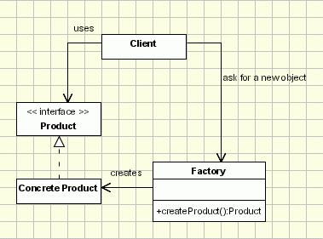
Factory Design Pattern
The client needs a product, but instead of creating it directly using the new operator, it asks the factory object for a new product, providing the information about the type of object it needs.
The factory instantiates a new concrete product and then returns to the client the newly created product (casted to abstract product class).
The client uses the products as abstract products without being aware about their concrete implementation.

Slide 19
Cohort Exercise 2 (10 min)
Given the pizza store example: PizzaStore.java, refactor the code using Factory Design Pattern.

Slide 20
Abstract Factory Pattern
It is like a factory, but everything is encapsulated.
The method that orders the object.
The factories that build the object.

Slide 21


No Factory:
I will make the objects myself.
What I want
Factory:
Objects
Order
Abstract Factory:
Objects

Slide 22
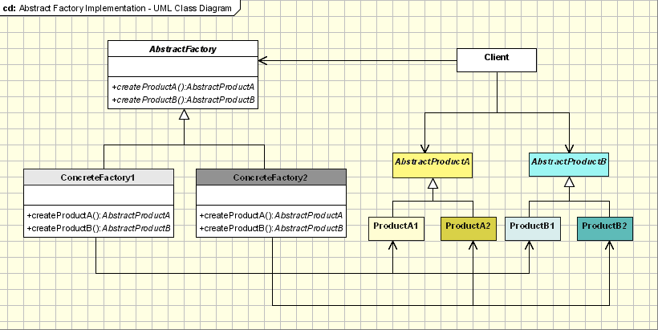
Abstract Factory Pattern

Slide 23
Strategy Design Pattern
How if we want to add a method called fly() which prints different message for flying or non-flying animals.
Assume that an animal may change its flying behaviors sometimes.
class Anmial {
…
public Animal() { … }
public void move(int i) { … }
public void eat() { … }
public void setName(String name) { … }
public String getName() { … }
}
class Dog extends Animal {
public void digHole () { … }
}
class Bird extends Animal {
public void move (int i) { … }
}

Slide 24
Strategy Design Pattern
Option 1: add the method in Animal and override it in the subclasses
class Anmial {
…
public Animal() { … }
…
public void fly() {
System.out.println(“I can fly.”);
}
}
Is this good?
class Dog extends Animal {
public void fly() {
System.out.println(“I cannot fly.”);
}
}
No. Too many repeated code.

Slide 25
Strategy Design Pattern
Option 2: Add two classes: FlyingAnimal and NonFlyingAnimal
class Animal {
public void fly() {};
}
class FlyingAnimal extends Animal {
public void fly() {
System.out.println(“I can fly.”);
}
}
class NonFlyingAnimal extends Animal {
public void fly() {
System.out.println(“I cannot fly.”);
}
}
class Dog extends NonFlyingAnimal { … }
class Bird extends FlyingAnimal { … }
Is this good?
No. Changing flying behavior would be hard.

Slide 26
Strategy Design Pattern
Option 3: Add an Interface and implement the interface
public interface Fly {
void fly() {};
}
class Bird extends Animal implements Fly {
public void fly() {
System.out.println(“I can fly.”);
}
}
class Dog extends Animal implements Fly {
public void fly() {
System.out.println(“I cannot fly.”);
}
}
Is this good?
No. Too many repeated code.

Slide 27
Strategy Design Pattern
The Solution: Add an Interface and implementations and instance variable.
public interface Flys { String fly(); }
class ItFlys implements Flys{
public String fly() {
return "Flying High";
}
}
class CantFly implements Flys{
public String fly() {
return "I cannot fly";
}
}
class Anmial {
public Flys flyingType;
public String tryToFly() {
return flyingType.fly();
}
}

Slide 28
Strategy Design Pattern
The solution: cont’d
public interface Flys { String fly(); }
class ItFlys implements Flys{
public String fly() {
return "Flying High";
}
}
class CantFly implements Flys{
public String fly() {
return "I cannot fly";
}
}
class Bird extends Animal {
public Bird () {
super();
flyingType = new CantFly();
}
}

Slide 29
Strategy Design Pattern
Animal
<interface> flys
+flyingType: Flys
+fly(): String
+ tryToFly(): String
+ setFlying(): void
Implements
ItFlys
CantFly
Extends
+fly(): String
+fly(): String
Dog
Bird
Define a family of algorithms, encapsulate each one, and make them interchangeable. The Strategy Design Pattern lets the algorithm vary independently from clients that use it.

Slide 30
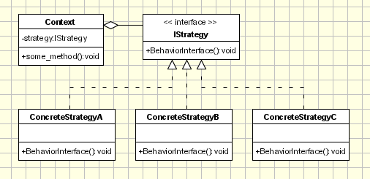
Strategy Design Patterns
Strategy - defines an interface common to all supported algorithms. Context uses this interface to call the algorithm defined by a ConcreteStrategy.
ConcreteStrategy - each concrete strategy implements an algorithm.
Context contains a reference to a strategy object.

Slide 31
When to Use the Strategy Pattern
When you want to define a class that will have one behavior that is similar to other behaviors in a list
When you need to use one of several behaviors dynamically

Slide 32
Cohort Exercise 3 (15 min)
Assume that you are programming a simulator with multiple interacting robots. There are three types of robot behaviors: aggressive, defensive and normal. Apply strategy design pattern to complete the code skeleton: RobotGame.java.

Slide 33
Observer Design Pattern
The Observer pattern is a software design pattern in which an object, called the subject, maintains a list of its dependencies, called observers, and notifies them automatically of any state changes, usually by calling one of their methods.

Slide 34
Observer Pattern: Example
Example:
Stock market with thousands of stocks needs to send updates to objects representing individual stocks.
The Subject (publisher) sends many stocks to the Observers
The Observers (subscribers) takes the ones they want and use them
iSubject.java; Observer.java; StockGraber.java; StockObserver.java

Slide 35
When to Use Observer Pattern
When you need many other objects to receive an update when another object changes. For instance,
The Subject (publisher) doesn’t need to know anything about the Observers (subscribers)

Slide 36
Singleton Pattern
Example 1 - Logger Classes
There should be only on logger object
The logger object should be globally accessible.
Example 2 - Configuration Classes
There should be only on configuration object
The configuration object should be globally accessible.

Slide 37
Singleton Pattern
class Singleton {
private static Singleton instance; private Singleton() { ... } public static synchronized Singleton getInstance() { if (instance == null) instance = new Singleton(); return instance; } public void doSomething() { ... } }

Slide 38
Cohort Exercise 4 (10 min)
Draw the class diagram for the Singleton pattern.
An alternative for the Singleton pattern is to use a class with static variables and all static methods. What is the difference then?

Slide 39
Decorator Pattern
Extending an object’s functionality can be done statically by using inheritance however it might be necessary to extend an object’s functionality at runtime as an object is used.
Consider the example of a graphical window. To extend the functionality of the graphical window for example by adding a frame to the window, would require extending the window class to create a FramedWindow class. To create a framed window it is necessary to create an object of the FramedWindow class. However it would be impossible to start with a plain window and to extend its functionality at runtime to become a framed window.
The intent of this pattern is to add additional responsibilities dynamically to an object.

Slide 40
Decorator Pattern: Example
Given the pizza class on the right, consider what if a customer could, at run-time, choose to add additional toppings like cheese or tomato or ham or else.
class Pizza {
public String ingredients () {
return "dough";
}
public double cost () {
return 3.0;
}
}
DecoratorDemoOriginal.java; DecoratorDemo.java

Slide 41
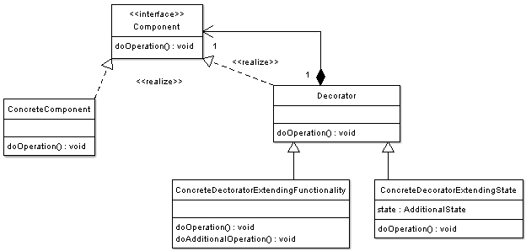
Decorator Design Pattern

Slide 42
Cohort Exercise 5 (10 min)
Complete DecoratorDemo.java by adding the ham topping.

Slide 43
Cohort Exercise 6 (10 min)
Given the ugly VisitorOriginal.java, study the Visitor Pattern by yourself, and apply the pattern to improve the code.

Slide 44
More Patterns
http://www.oodesign.com/

